Slide 1






Blockchain Education for Aetna
Presenters:
Jin VanStee
Austin Grice
Barry Silliman
Special Thanks To:
Dave Wakeman
Daniel Acosta
Kevin Lee

Slide 2
2-Day Education Agenda
Day 1
Blockchain Explained
Blockchain Solutioned
Demo of IMMUNIChain
Day 2
Blockchain Composed
Composer Lab using IMMUNIChain
Notes:
Our goal over the next two days is to provide you with an introduction to blockchain, as well as take a look at the tooling available to design and test out a blockchain use case. At the end of the two day education, you will have knowledge to articulate why blockchain is valuable in today’s world, and you will gain insight into how you can begin to design your own blockchain business network. Right in time for your Innovation Tournament.
Day 1 is focused on providing a high level introduction to blockchain concepts and its business value, and we will also be providing solution examples in the Insurance and Healthcare industry. It is very important to understand the value of blockchain and its four tenants (consensus, provenance, immutability, and finality), they should be on top of mind as you are developing uses cases for the Innovation Tournament.
Day 2 is focused on applying the concepts learned in Day 1 into actually creating a blockchain business network using open source tooling available only with Hyperledger Project. You will have the opportunity to try a one of a kind lab to get familiarized with the tool which will also help solidify the concepts from Day 1.

Slide 3











Blockchain Composed
A Technical Introduction to Hyperledger Composer
Blockchain education series
Explained Solutions
V2.0, 23 August 2017
© 2017 IBM Corporation
Composed
Architected
Explored
Next Steps

Slide 4

Contents
What is Hyperledger Composer
Application Development
Writing the application
Modeling the business network
Effective Administration
Deploying to a blockchain Interacting with systems of record

Slide 5
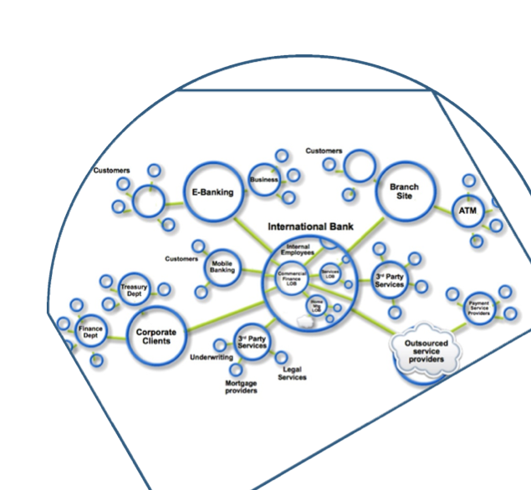
Blockchain Recap
Blockchain builds on basic business concepts
Business Networks connect businesses
Participants with Identity
Assets flow over business networks
Transactions describe asset exchange
Contracts underpin transactions
The ledger is a log of transactions
Blockchain is a shared, replicated ledger
Consensus, immutability, finality, provenance
5

Slide 6
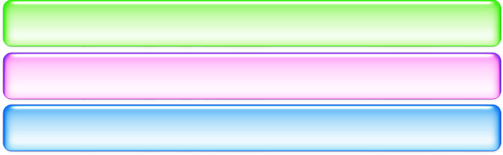





Hyperledger Composer: Accelerating time to value
https://hyperledger.github.io/composer/
A suite of high level application abstractions for business networks
Emphasis on business-centric vocabulary for quick solution creation
Reduce risk, and increase understanding and flexibility
Business Application
Hyperledger Composer
Blockchain (Hyperledger Fabric)
Features
Model your business networks, test and expose via APIs
Applications invoke APIs transactions to interact with business network
Integrate existing systems of record using loopback/REST
Fully open and part of Linux Foundation Hyperledger
Try it in your web browser now: http://composer-playground.mybluemix.net/
6

Slide 7




Benefits of Hyperledger Composer
Increases understanding
Bridges simply from business concepts to blockchain
Saves time
Develop blockchain applications more quickly and cheaply
Reduces risk
Well tested, efficient design conforms to best practice
Increases flexibility
Higher level abstraction makes it easier to iterate
7

Slide 8

User Roles in a Blockchain Project
Application Developer
Developing the application that interacts with the ledger
D
Modelling the business network
Implementing the script files that define transaction behaviour
Solution Administrator
Provisioning the target environment
Deploying the business application
Managing the blockchain
Business Network Participant
A
Running an end-user application that invokes transactions
Aware of business concepts: assets, participants and transactions
May not be aware of blockchain underpinnings
P
© 2017 IBM Corporation
7

Slide 9
Contents
What is Hyperledger Composer
Application Development
Writing the application
Modeling the business network
Effective Administration
Deploying to a blockchain Interacting with systems of record

Slide 10



Example: Vehicle Auction
Developer
develops
P
model
D
develops
transaction logic
Vehicle
Vehicle Listing
develops
Vehicle Registry
_{PP}P
Members, Auctioneers
use
S D K
Application
Place Offer Close bidding
Vehicle Listing Registry
defined in
Transaction Registry
Member Registry
Auctioneer Registry
10

Slide 11



Developer Concepts
Applications
Models
Scripts
Provides front-end for the user
May require different applications per participant
Interacts with the registries
Add, delete, update, query
Registries persisted on blockchain
Connects to blockchain via JavaScript client libraries (SDK) or REST
A domain specific language (.CTO) that defines the type structure of
Assets
Participants
Transactions
Aims to match how we talk about business networks in the real world
Scripts provide the implementation of transaction processor logic
Specified in Javascript
Designed for any reasonable Javascript developer to pick up easily

Slide 12




Vehicle Auction
Applications
Models
Scripts
Vehicle
Vehicle Listing
Place Offer
bidPrice
(References a) listing, member
Close Bidding
(References a) listing
VIN
listingId, reservePrice,
_{(References a) Member} description, state, offers[]
develops
P
model
(References a) Vehicle
D
develops
transaction logic
Vehicle
Vehicle Listing
develops
Vehicle Registry
User
email, firstName, lastName
Member (extends User) balance
use
S D K
_{P}P
P
Application
Place Offer Close bidding
Members, Auctioneers
Vehicle Listing Registry
Auctioneer (extends User)
App
App
App
defined in
Place Offer
If listing is for sale, add offer to this vehicle listing’s offers[]
Close Bidding
If reserve price met Increment seller’s balance
Decrement buyer’s balance Change owner to buyer
Transaction Registry
Member Registry
Auctioneer Registry

Slide 13
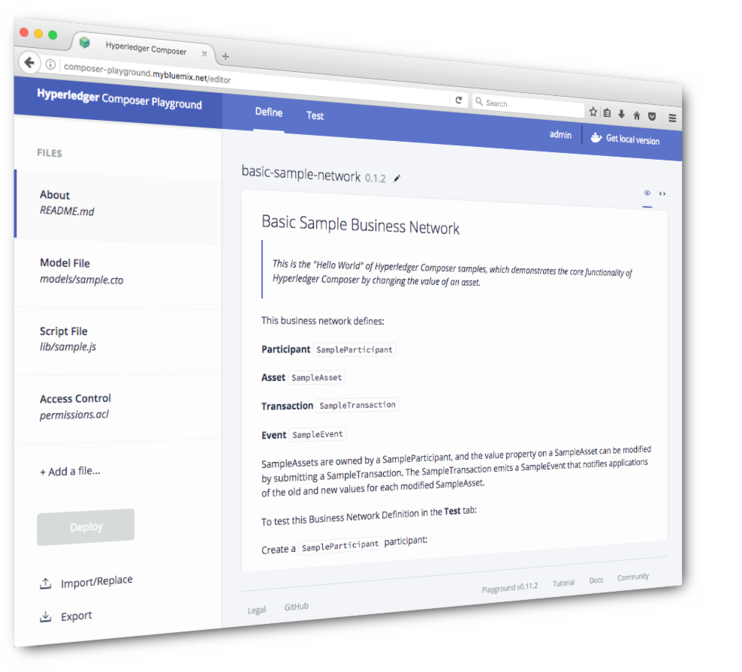
Tools: Composer Playground
Web tool for defining and testing Hyperledger Composer models and scripts
Designed for the application developer
Define assets, participants and transactions
Implement transaction processor scripts
Test by populating registries and invoking transactions
Deploy to instances of Hyperledger Fabric V1, or simulate completely within browser
Install on your machine or run online at http://composer-playground.mybluemix.net

Slide 14
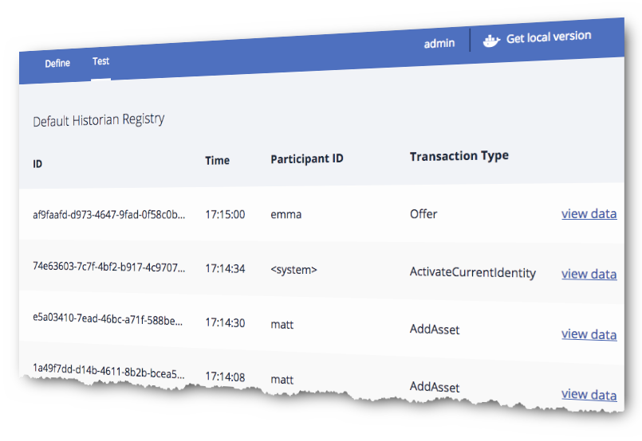
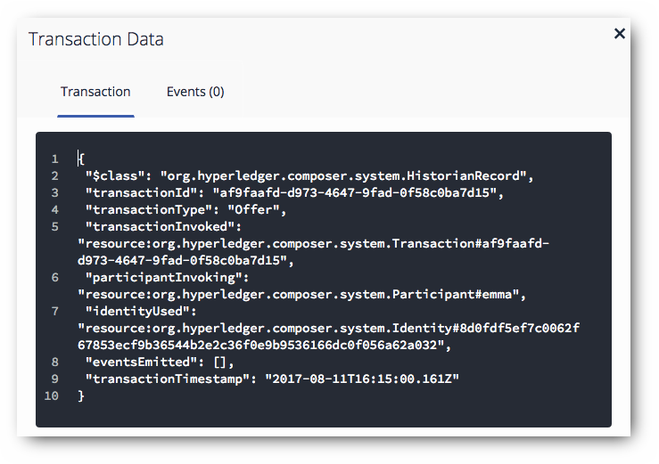
Historian
Playground Historian allows you to view all transactions
See what occurred and when
Diagnostics framework allows for application level trace
Uses the Node.js logging framework
More information online:
https://hyperledger.github.io/composer/problems/diagnostics.html

Slide 15
Contents
What is Hyperledger Composer
Application Development
Writing the application
Modeling the business network
Effective Administration
Deploying to a blockchain Interacting with systems of record
19

Slide 16


Resources are packaged into BNA files
Business Network Archive (.BNA) is a package of the resources used by Fabric:
Model files (.CTO)
Transaction processors (.JS)
Access Control Lists (.ACL)
Static queries (.QRY)
Documentation and versioning (.MD)
It does not contain the client application
The BNA simplifies deployment of blockchain and promotion between environments
Create BNA files from Playground or command line
Business Network Archive
P
P
model.cto
logic.js
rules.acl
?
queries.qry
readme.md
composer archive create –archiveFile my.bna
--sourceType module --sourceName myNetwork

Slide 17
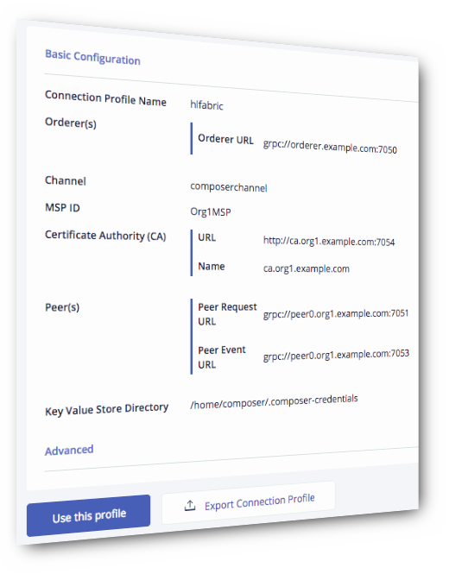
Deployment to Hyperledger Fabric
– Command line tool to script deployment
composer network deploy -p myProfile -a my.bna -i user -s secret
Use Connection profiles to describe Fabric connection parameters
Export from Playground, generate from script or create by hand
Enrollment in Hyperledger Fabric network required
Issue Fabric identity from Composer participants
Additional command line options for management of business network
For example: download, list, start, undeploy, upgrade…

Slide 18
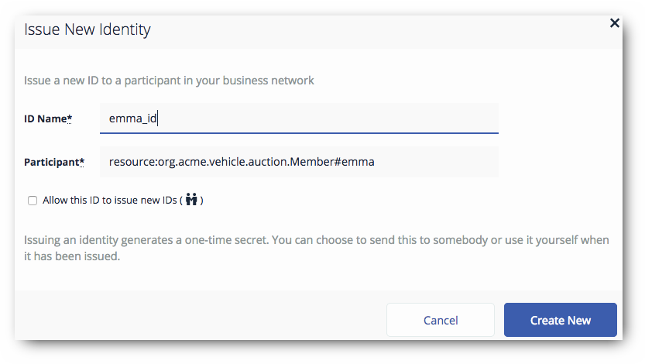
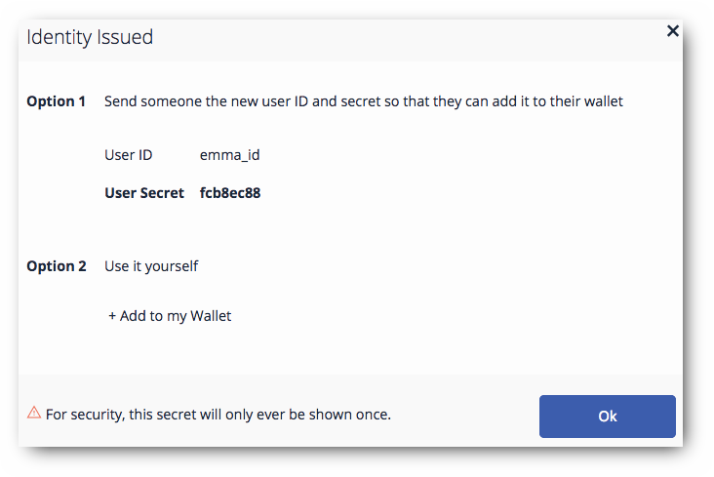


Participant Identity
Participants require an identity in order to connect to Hyperledger Fabric
Issued by the administrator as a Hyperledger Fabric userid/secret
Supplied by the participant when the client application connects
Composer Participant to Fabric Identity mapping is stored on the blockchain in an identity registry
Perform identity management from Playground, Javascript, REST or command line
For example: Test connection, issue identity, bind an identity to a participant, revoke an identity, list identities
businessNetworkConnection.connect
('hlfv1', ’my-network', ’emma_id', ’fcb8ec88')

Slide 19

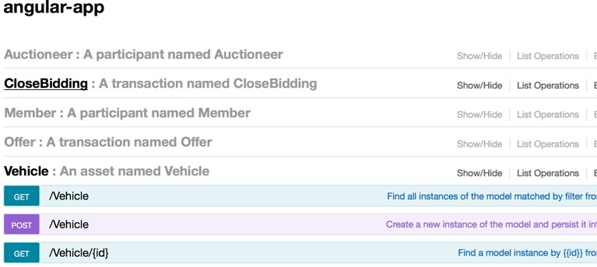

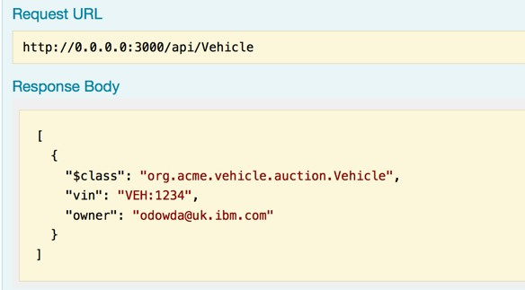
Systems of Record Integration
Domain specific APIs very attractive to mobile and web developers. Resources and operations are business-meaningful
Composer exploits Loopback framework to create REST APIs: https://loopback.io/
Extensive test facilities for REST methods using loopback
Composer provides back-end integration with any loopback compatible product
e.g. IBM Integration Bus, API Connect, StrongLoop
Outbound and Inbound (where supported by middleware)

Slide 20
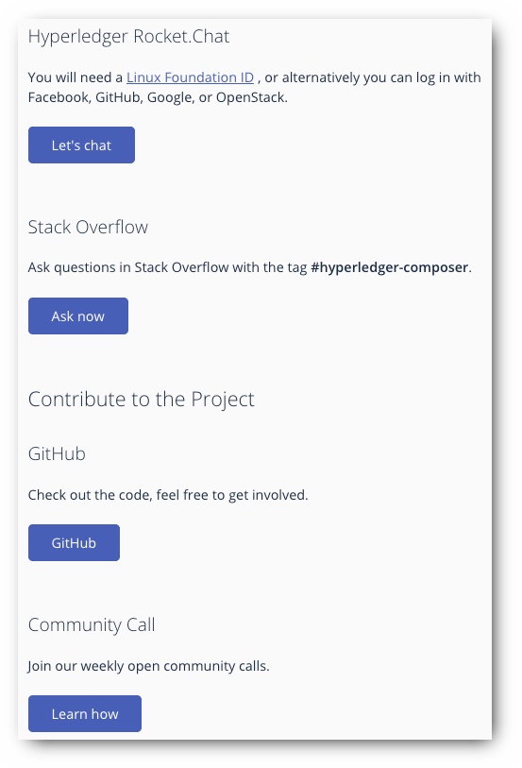
Hyperledger Composer Outlook
Still early in product lifecycle
Lots of improvements planned
– See https://github.com/hyperledger/composer/issues
An active development community
Open community calls every two weeks
Rocket Chat
Stack Overflow
Get involved!

Slide 21

Get started with Hyperledger Composer!
Define, Test and Deploy Business Networks
Create domain APIs and sample applications
Integrate existing systems and data
https://hyperledger.github.io/composer/ http://composer-playground.mybluemix.net/
28

Slide 22
Benefits of Hyperledger Composer
Increases understanding
Bridges simply from business concepts to blockchain
Saves time
Develop blockchain applications more quickly and cheaply
Reduces risk
Well tested, efficient design conforms to best practice
Increases flexibility
Higher level abstraction makes it easier to iterate
22

Slide 23
Thank You
Jin VanStee
jinxiong@us.ibm.com
Barry Silliman
silliman@us.ibm.com
Austin Grice
austin.grice@ibm.com
Dave Wakeman
dwakeman@us.ibm.com
Daniel Acosta
acostad@us.ibm.com
Shaun McGarry
smcgarry@us.ibm.com

